Slide 1


Bonus Management & Order Processing
VDMS PROJECT
VMEP & Thang Long Software
Notes:
[Notes to trainer:
For detailed help in customizing this template, see the very last slide. Also, look for additional lesson text in the notes pane of some slides.
Because this presentation contains a Macromedia Flash® animation, saving the template may cause a warning message to appear regarding personal information. Unless you add information to the properties of the Flash file itself, this warning does not apply to this presentation. Click OK on the message.]

Slide 2
Change Request Contents
Apply New Order processing (VDMS & Tip-Top)
Apply Bonus Management & Cancel Paper.
Apply Auto Re-consign for FIN Dept.
New Sales Reports for Sales ADM.

Slide 3
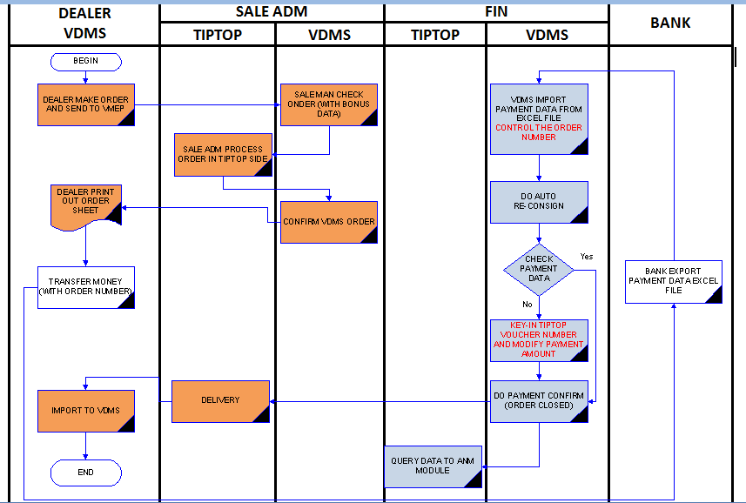

Ordering process flow

Slide 4
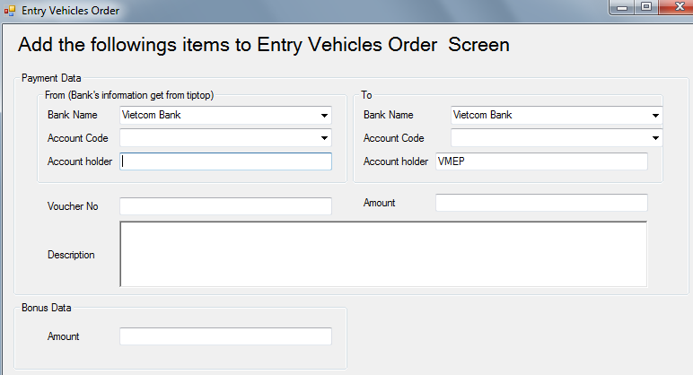
1. Make new Order & Send to VMEP (change function) - Dealers
Change current order screen as below:
The Bonus deductions: Add more fields allow dealer key-in the bonus data (get and check bonus data in Bonus Management module). They can keep these fields blank. These data should be apply when dealer modify order.
The Payment Data: Add fields allow dealer can key in the Payment data (as new order sheet form came from SALE)
  In case: Dealer have the payment data before make the order, dealer can key-in at this time.
In case: Dealer do not have the payment keep blank.

Slide 5
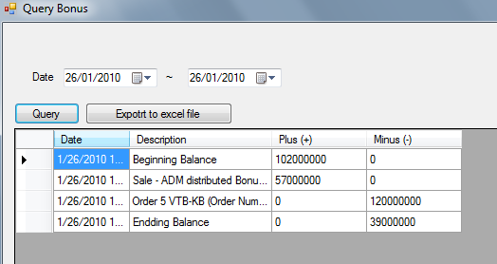
2. Query Bonus – Dealers
Bonus money tracking & query.
chương trình VDMS phải có thêm phần theo dõi đối trừ cho Đại lý, trên đó thể hiện : tổng số tiền chiết khấu hàng tháng, đã đối trừ được bao nhiêu, còn lại bao nhiêu có thể đối trừ …

Slide 6
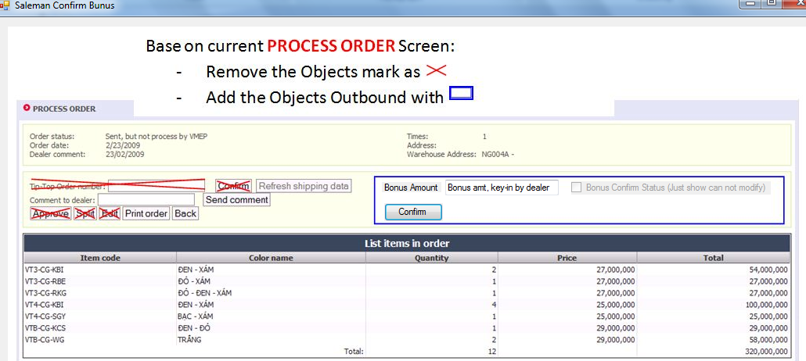
3. Sales man check order & confirm bonus
Get Order data and confirm for bonus status only by sale man.

Slide 7
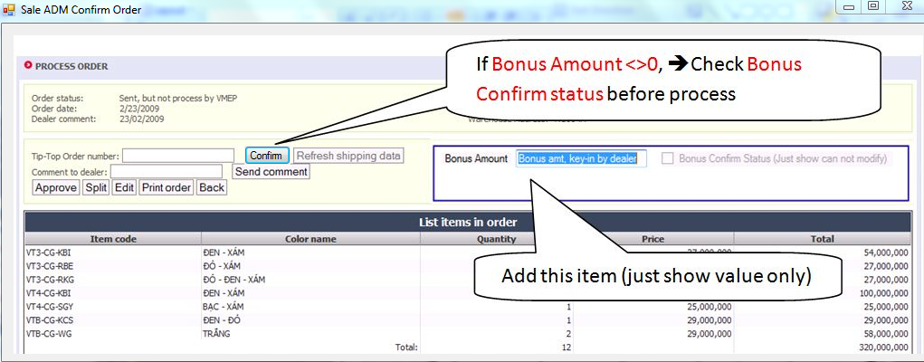
4. Sales ADM process Order at Tip-Top side & Confirm Order at VDMS
1. Sale ADM create order at Tip-Top site:
- Need Sale ADM choose 1 in the flowing case:
* Manual case: Keep current order screen (cxmt411), Sale ADM key-in tiptop order manual
* Auto Carrying Case: Change the tiptop order screen (cxmt411): add one more field in this screen, Sale ADM key-in VDMS order number, program should carry VDMS order data to tiptop (like VDMS-II). Sale ADM just check the order data in TIPTOP. If Sale ADM pass through the VDMS Order number (it’s null) ➔ back to Manual Case .
2. Sale ADM confirm order at VDMS site:

Slide 8
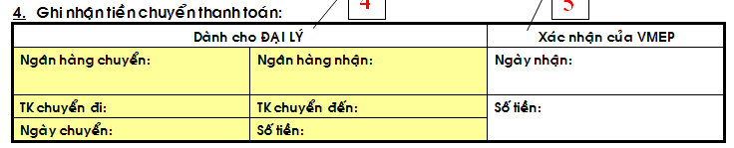
5. Dealer key-in payment data (Update the Entry Order like fields below)
Change the current Order Edit Screen: Allow dealer can modify the payment data and Bonus Data in orders has been send (not yet confirmed in tiptop side)

Slide 9
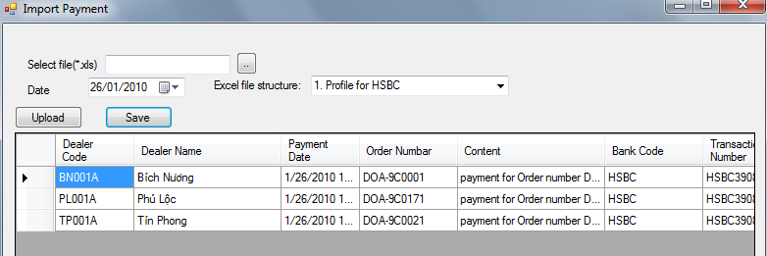
6. Upload payment data from Excel file (Bank payment data)
  Each Bank has difference Excel file format (suggest that, system provide the parameters to define the excel file structure)
    HSBC
    VCB
    ACB
    ANZ

Slide 10
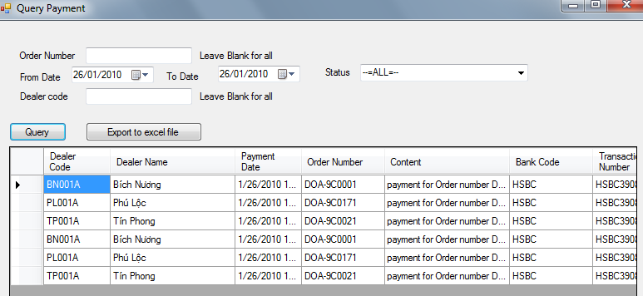
7. Check payment data before Re-Consign
  Create the preview screen before process the Re-consign. This screen summary the payment from Dealers, it has these columns:
    Dealer code
    Dealer Name
    Payment amount
    Payment Date
    Order Number
    Content, Bank Code, Transaction number.

Slide 11
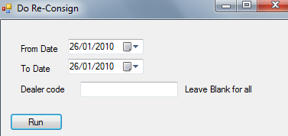
8. Do Auto Re-Consign
When compare payment amount and Order Amount:
Combine the Payment amount (From Banks) and Bonus Amount (from Bonus Management)
Payment Amount = Bonus Amount (Dealer key-in on each order) + Bank Payment amount (From Bank’s data)
2. Query Re-Consign conditions
      Order Number
      Time range (From date …. To date)
      Dealer code
      Order Status (Payment confirmed or not)
One Order has many payments ➔ do total payment
On doing re-consign:
1. If payment amount greater than Order Amount: Separate the payment amount to 2 parts:
        Equal to Order payment amount
        Remaining amount (may be used for next orders, has remark)
The tiptop should used this data for module ANM. Allow tiptop get data has been confirm in VDMS side.
2. In case payment amount less than Order Amount: high-light the Orders and the allow VMEP’s FIN change the Payment data with these fields: Description and the TIPTOP voucher (more details in FIN confirm payment)

Slide 12
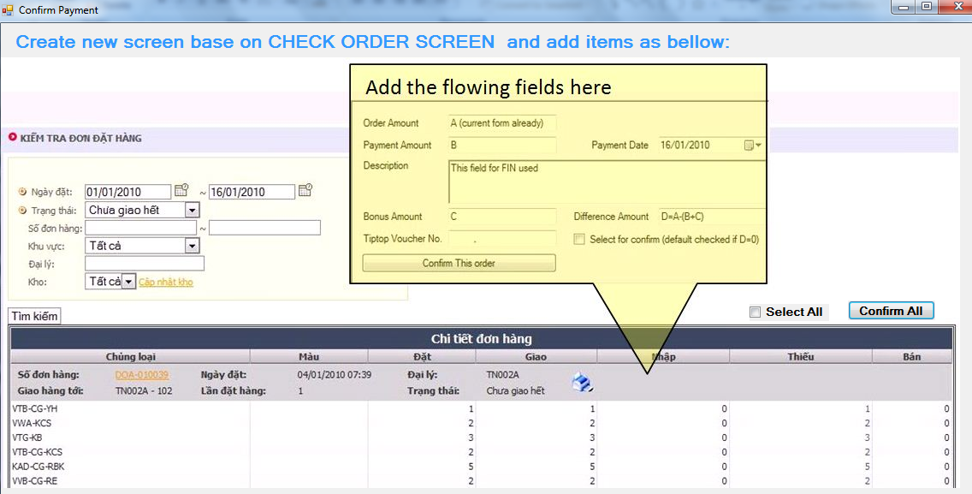

9. Confirm Payment (FIN)

Slide 13
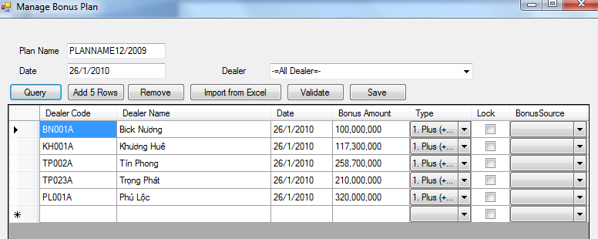
10. Management Bonus Plan (Sale ADM)
Sale ADM define the bonus plan for each dealer in each month (Insert, Update, Delete, Report balance)

Slide 14
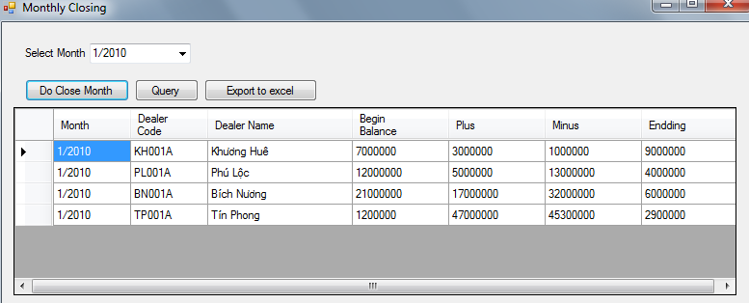
11. Bonus Monthly Close (Sale ADM)
Sale ADM close bonus in each month to calculate bonus balance)

Slide 15
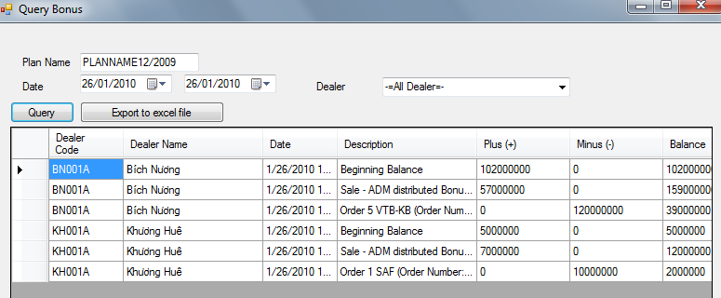
12. Query Bonus (Sale ADM)
Sale ADM do query for bonus data reference

Slide 16
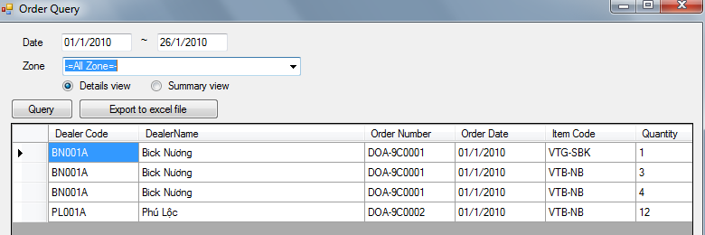
13. Order Static Report (Sale ADM)

Slide 17
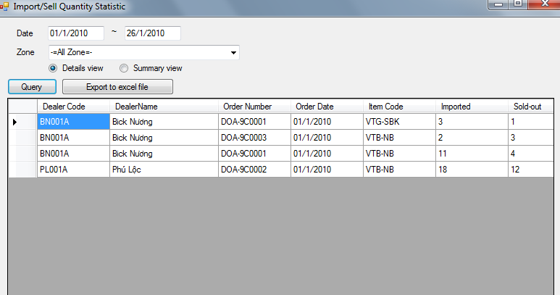
14. Import/Sold-out Static Report (Sale ADM)

Slide 18
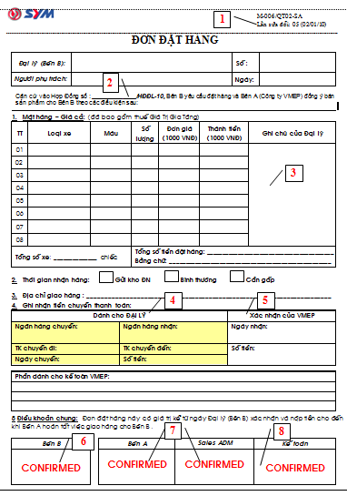
15. Order Sheet (Update layout)

Slide 19
16. System Setting
Define Excel payment data structure.
…..?

